Slide 1

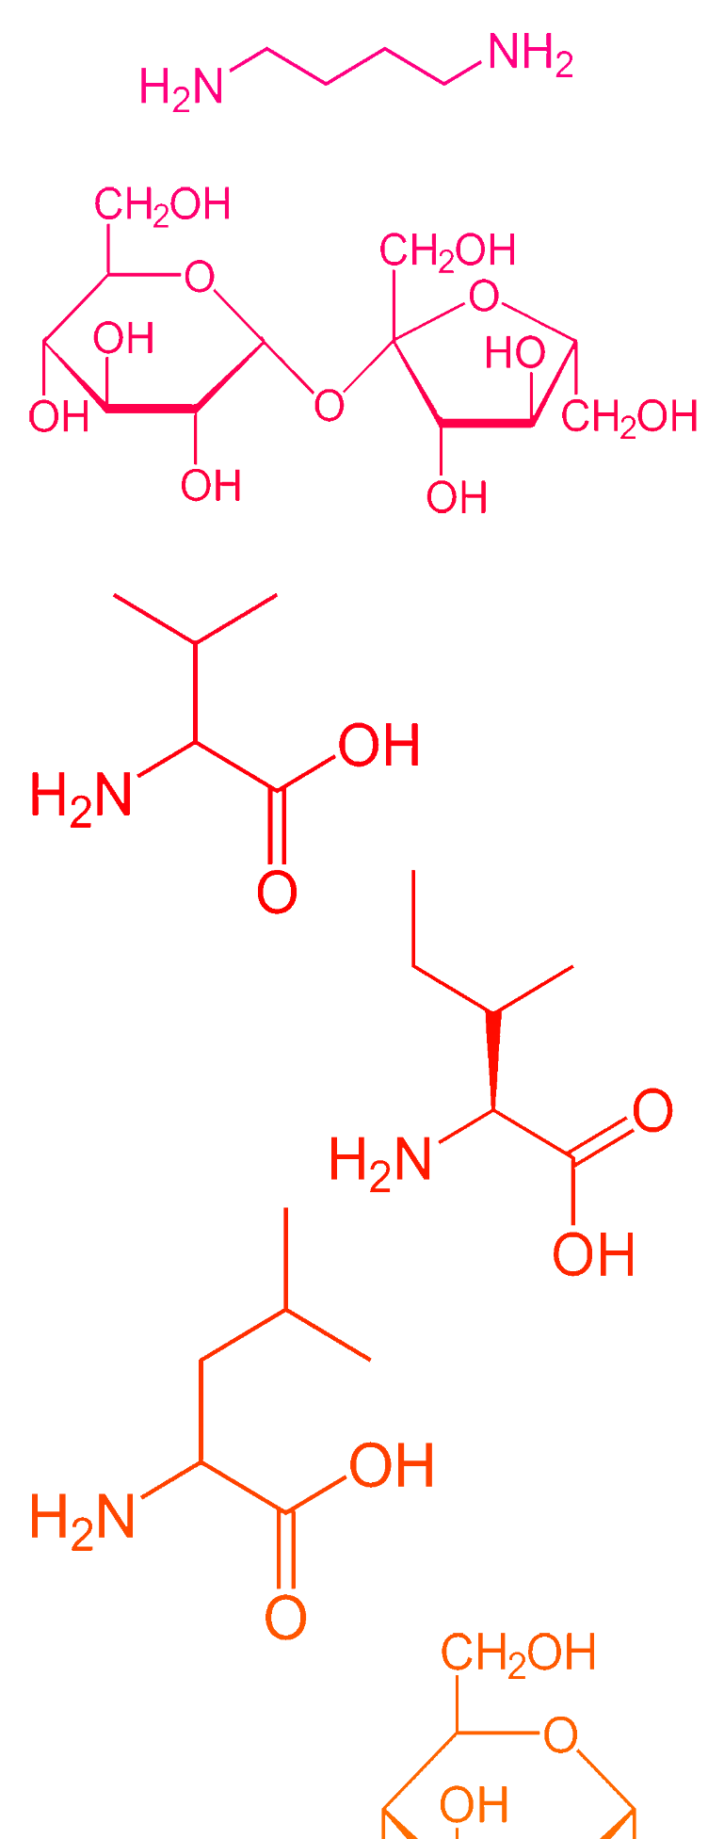
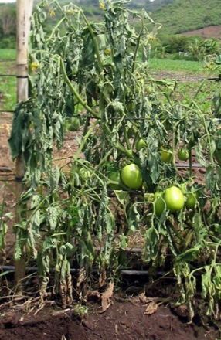
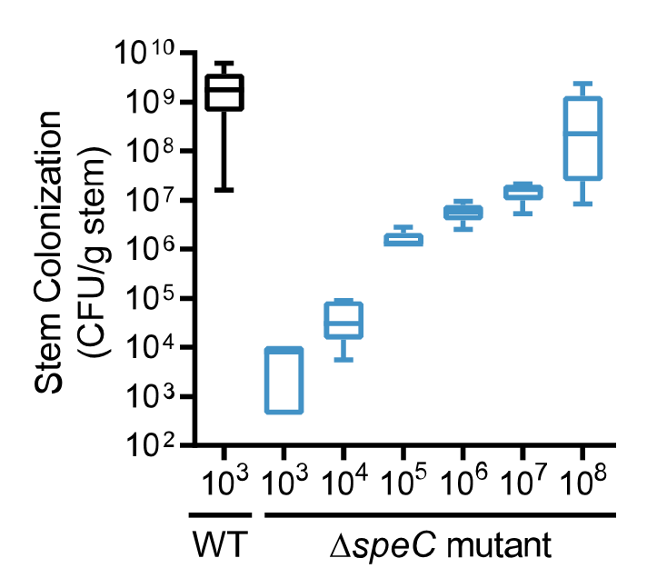
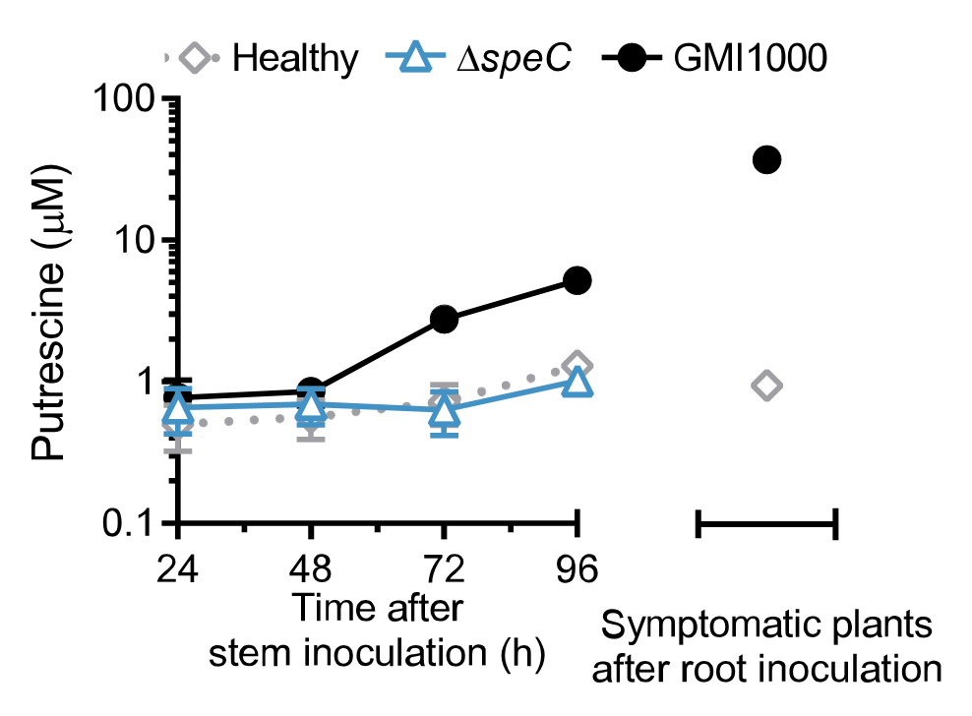

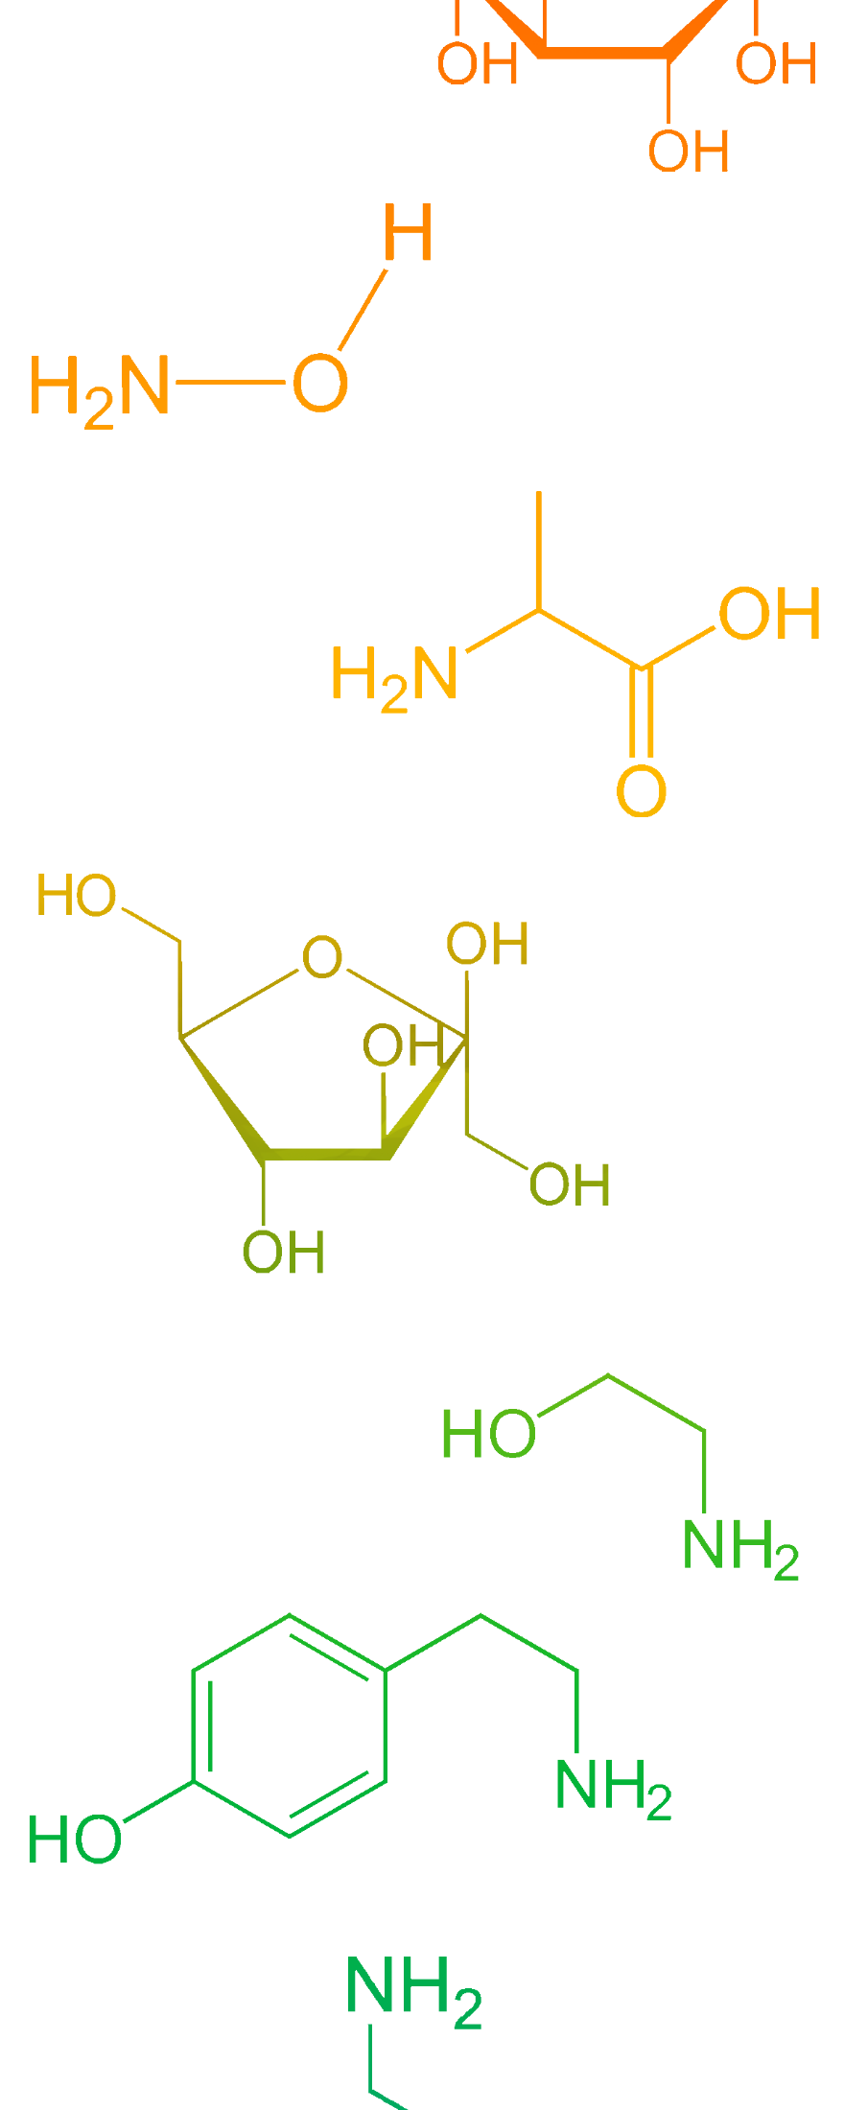
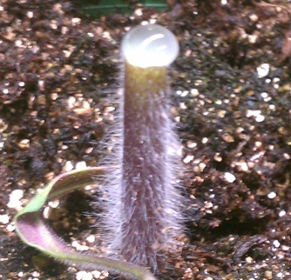

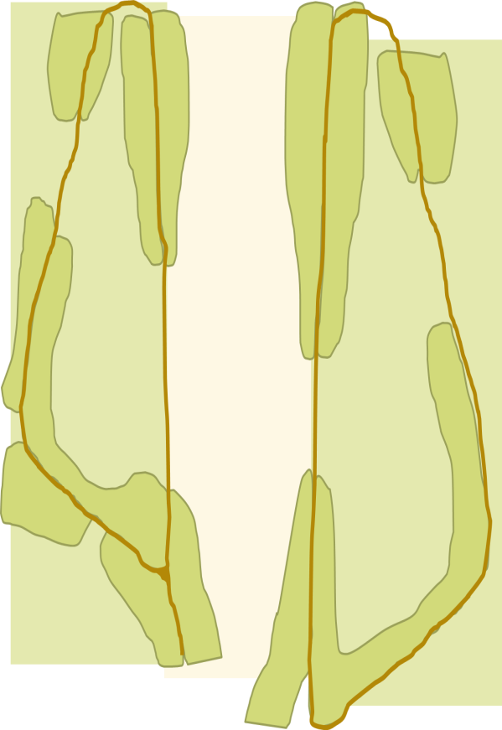
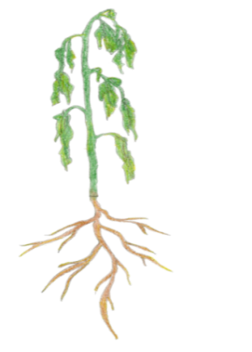
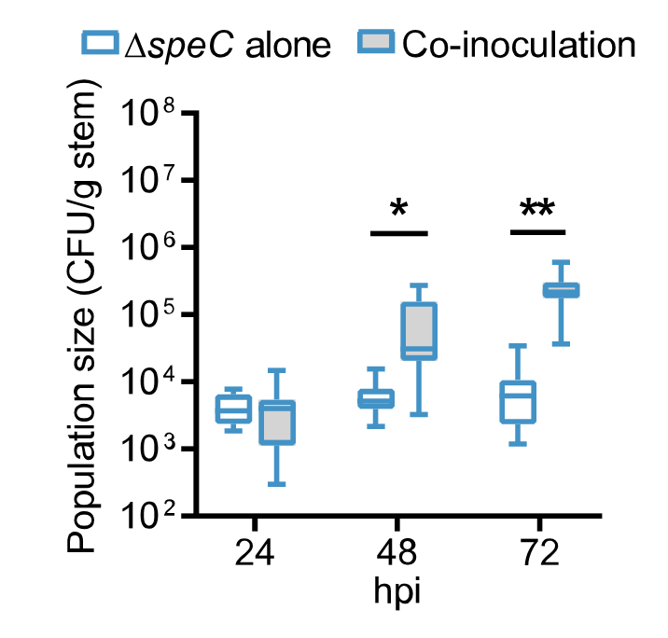
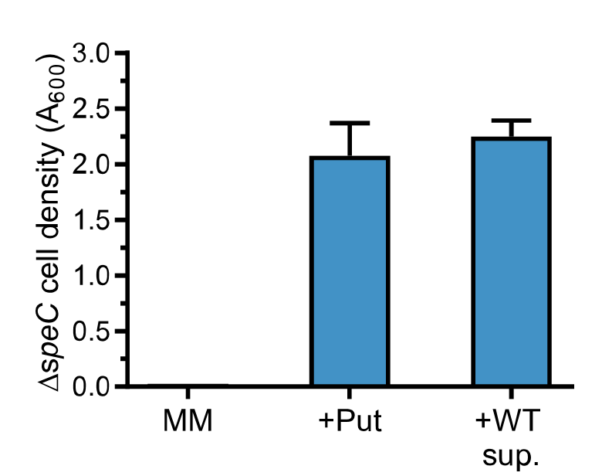
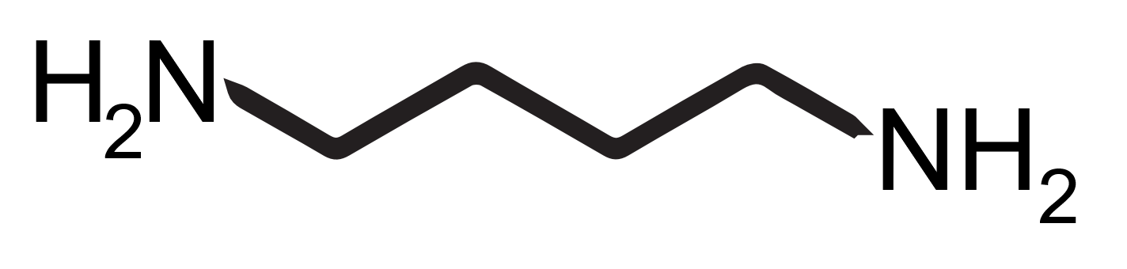
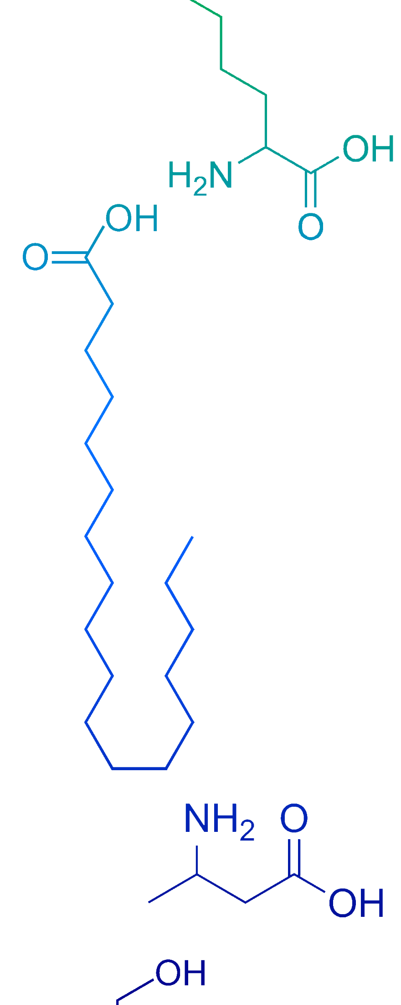
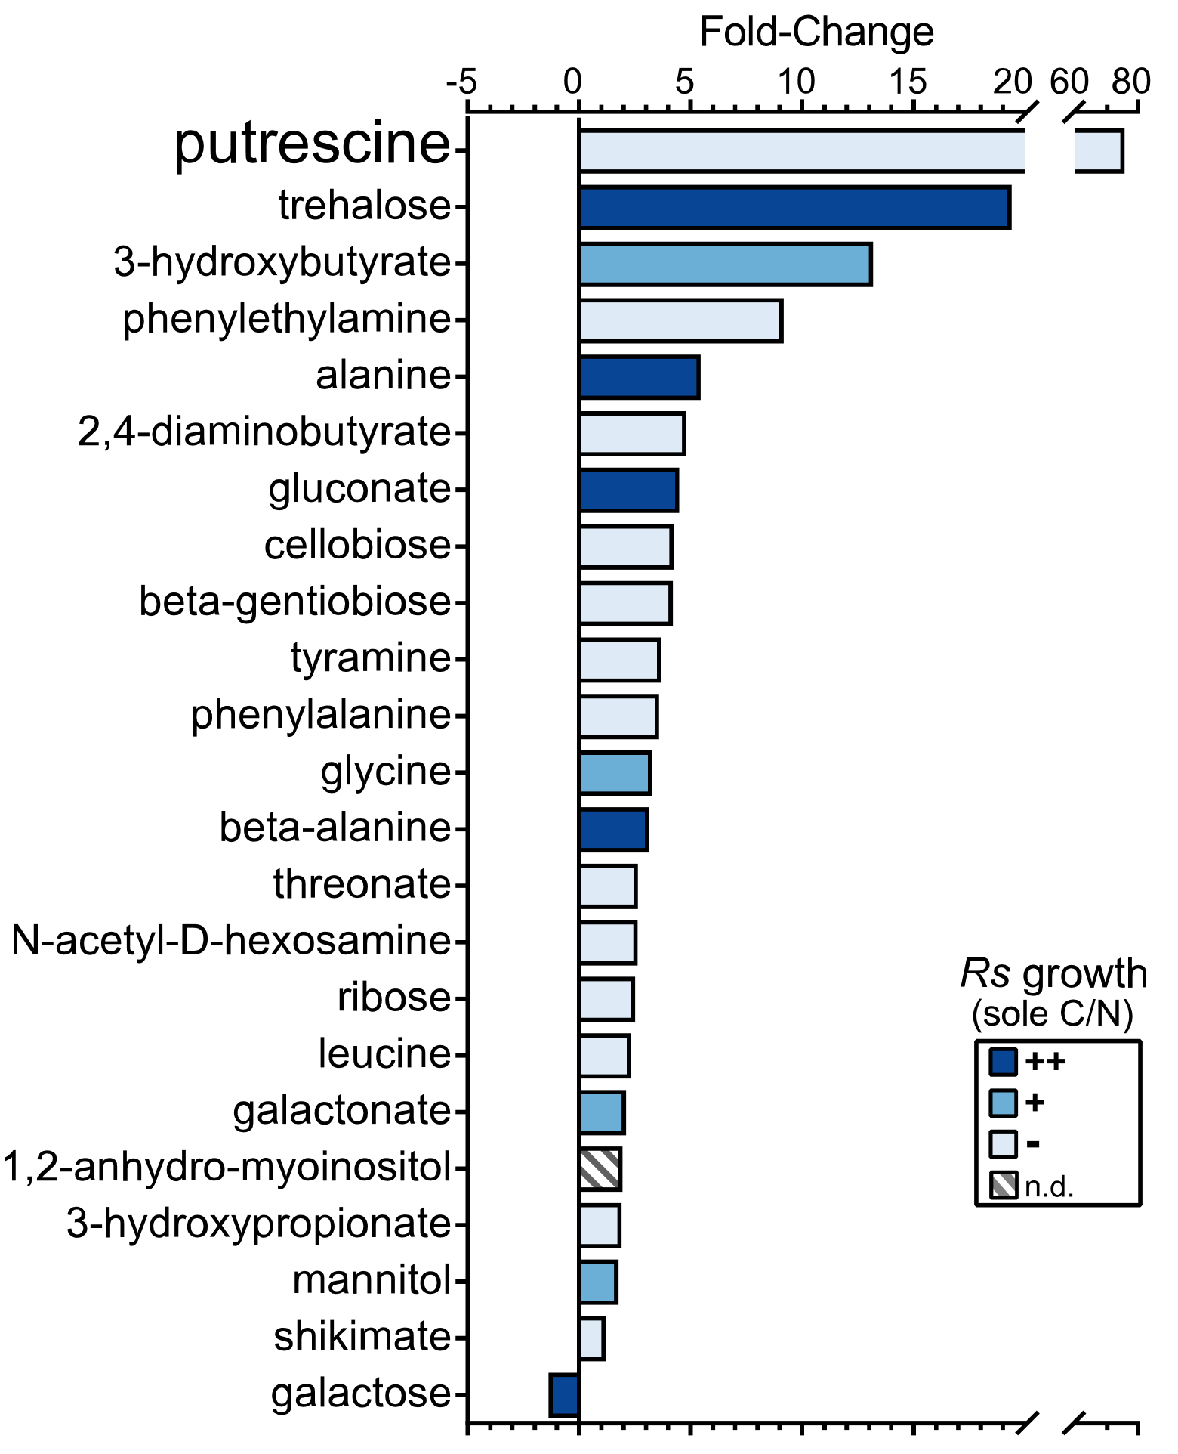
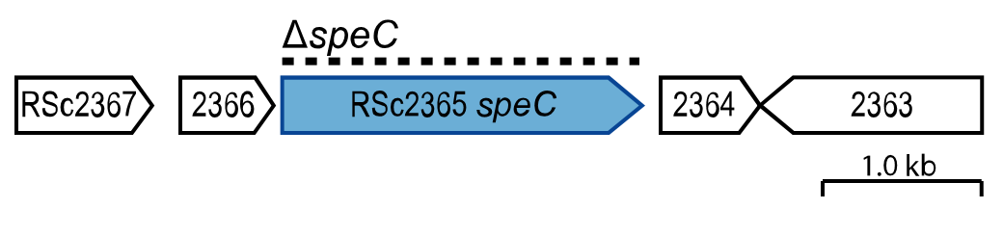
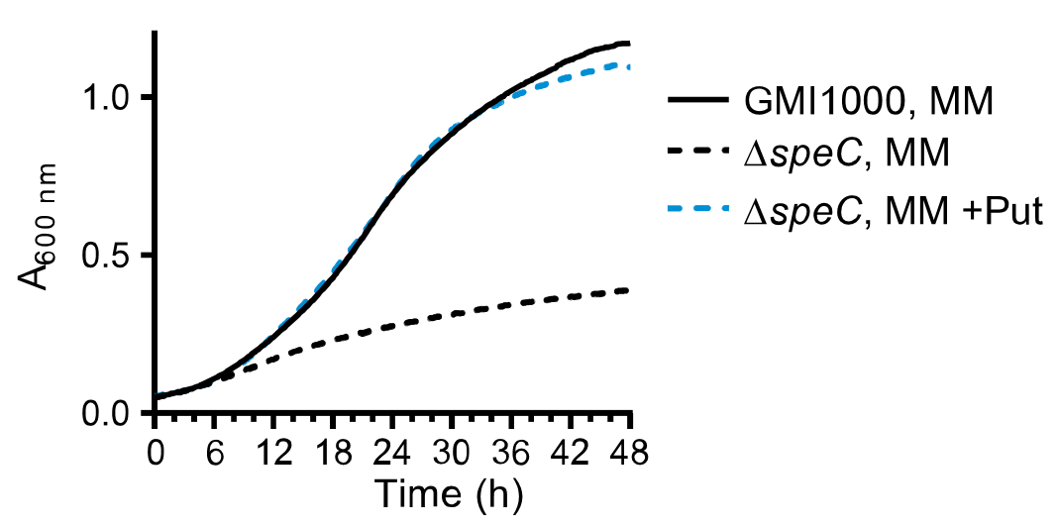
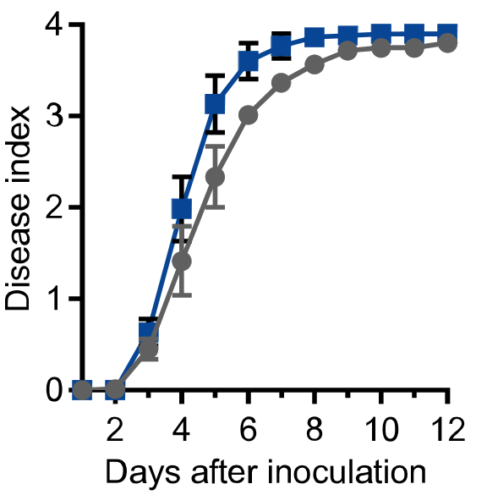
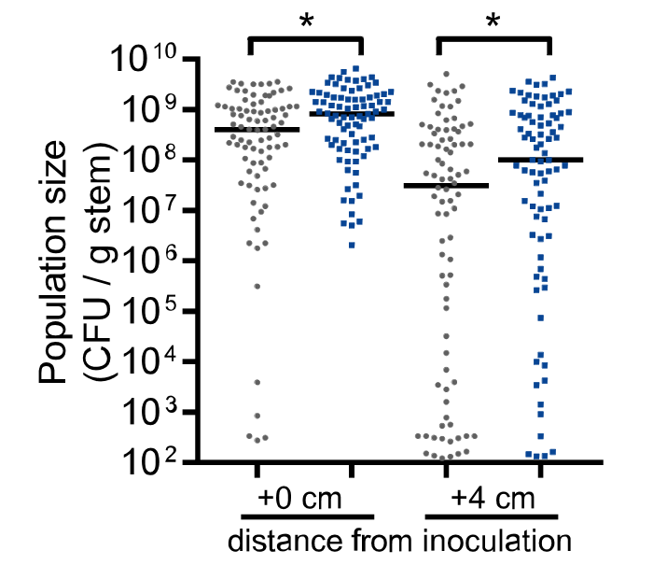
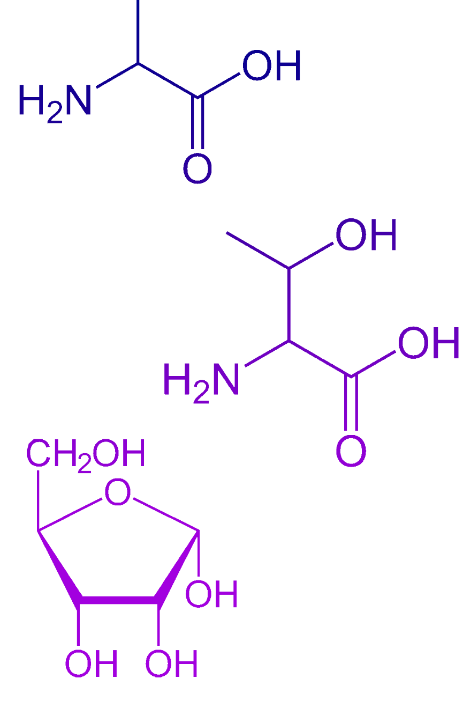







Ralstonia solanacearum (Rs)-produced putrescine accelerates bacterial wilt disease of plants
Tiffany M Lowe-Power, Connor Hendrich, Edda Von Roepenack-Lahaye, Bin Li, Duosheng Wu, Raka Mitra, Beth Dalsing, Patrizia Ricca, Jacinth Naidoo, Amy Jancewicz, Patrick Masson, Thomas Lahaye, Anthony Michael, Caitilyn Allen Affiliations: Univ. of Wisconsin-Madison, Univ. Tuebingen, Germany, Univ. Texas Southwestern, Carleton College
Background: Bacterial wilt disease
Background: Bacterial wilt disease
Rs ΔspeC mutant is a biosensor for putrescine
If tomato plants produce the enriched putrescine found in xylem sap of Rs-infected plants, the ΔspeC mutant should grow in tomato xylem.
Rs infection enriches nutrients for Rs in xylem sap and enriches the polyamine putrescine, which is not a carbon or nitrogen source for Rs.
Rs produces the enriched putrescine via the SpeC ornithine decarboxylase.
Putrescine treatment accelerates bacterial wilt disease on tomato.
Rs ΔspeC mutant is a biosensor for putrescine
Take Home Points
Take Home Points
R. solanacearum (Rs) infects plant xylem vessels and causes bacterial wilt disease
How does Rs grow to >10⁹ CFU/stem in nutrient-poor xylem?
1.
ΔspeC does not grow in
tomato xylem.
Putrescine is not enriched after ΔspeC inoculation.
Aim: Use metabolomics to understand how Rs manipulates xylem sap.
2.
Rs-infected tomato plant
Tomato xylem sap metabolomics
Tomato xylem sap metabolomics
Putrescine is enriched 75-fold in sap from infected plants.
Does the host or pathogen produce the putrescine?
Putrescine is enriched 75-fold in sap from infected plants.
Healthy tomato plants
GC-MS at UC-Davis metabolomics core (West Coast Metabolomics)
Sample size:
N=5 pools of 4 plants
ΔspeC population sizes 3 d after stem inoculation reflect the inoculum dose (X-axis). In contrast, WT grew. (N=5)
LC-MS measurements of putrescine in xylem sap harvested from healthy plants and plants infected with wildtype (GMI1000) or ΔspeC. (N>3)
Tomato Put Synthesis
Rs Put Synthesis
Ornithine
Wildtype Rs exports putrescine in vitro and in planta
Culture supernatant from the wildtype restores growth of the speC mutant in vitro, and co-inoculation with wildtype partially restores speC growth in tomato xylem
Symtomatic, Rs GMI1000-infected plants
Plants detopped and xylem sap harvested for 30 min
SpeC
(ODC)
Wildtype Rs exports putrescine in vitro and in planta
Ornithine
ODC
36.9 µM Putrescine
Rs infection increases nutrient density in xylem sap
22 metabolites are enriched and only 1 is depleted in sap from infected plants (FDR<0.1). Nine of the enriched metabolites are carbon/nitrogen sources for Rs, which enables Rs to grow better in sap from infected plants (data not shown).
Rs infection increases nutrient density in xylem sap
Arginine
ADC
AIH
CPA
ODC: ornithine decarboxylase and ADC: arginine decarboxylase
Rs ΔspeC mutant is a putrescine auxotroph
Rs ΔspeC requires at least 30 µM putrescine (Put) to grow. Putrescine is not a carbon/nitrogen source for Rs (data not shown). The mechanism underlying Rs’s putrescine requirement is unknown, but bacteria like Agrobacterium tumefaciens and Campylobacter jejuni require the related polyamine spermidine for growth.
Rs ΔspeC mutant is a putrescine auxotroph
.
Culture supernatant from GMI1000 (+WT sup.) rescues ΔspeC growth in vitro. N=3
Co-inoculation with wildtype GMI1000 partially rescues ΔspeC growth in tomato. N=20, *P<0.05, **P<0.01
Putrescine accelerates bacterial wilt disease
Pretreating roots and leaves of tomato plants with 0.5 mM putrescine accelerated wilt symptom development and growth and spread of Rs within the xylem. Treatment did not increase putrescine levels in xylem sap (data not shown), suggesting that putrescine accelerated wilt disease via an indirect effect on host plant physiology.
Putrescine accelerates bacterial wilt disease
Growth of speC in glucose/ammonium minimal media (MM) ±30 µM putrescine (Put). N=3.
Putrescine treatment accelerated Rs wilt symptoms (0-4 scale corresponds to % leaves wilted)
Putrescine treatment increased growth and spread of Rs in xylem.
Affiliations/Funding:

